Slide 1
Lexical content for Yemba
An under-resourced language
Lionel TADJOU
Research engineer at INRIA

Slide 2
Outline
Context
The Yemba language
Under-resourced laguages survey
Why I’m here?

Slide 3
Context – Under resourced languages
Definition
  Spoken by a few number of people
  With few available corpora
  Most of African languages
Main issue
  Absence of tools to learn them
  Disappearance of these langauges

Slide 4
Context – Interrogations
How to create a normative grammar (using differents rules
define in dictionnary) ?
Based on these grammar, how to generate corpora?
How to use these corpora for learning language tools ?
Identify commonalities on languages of same sub-groupes

Slide 5
Context – Approaches
Learning tools
    With NLP technologies
    Computational linguistic concepts
    Intelligent tutoring systems
    Web/mobile application

Slide 6
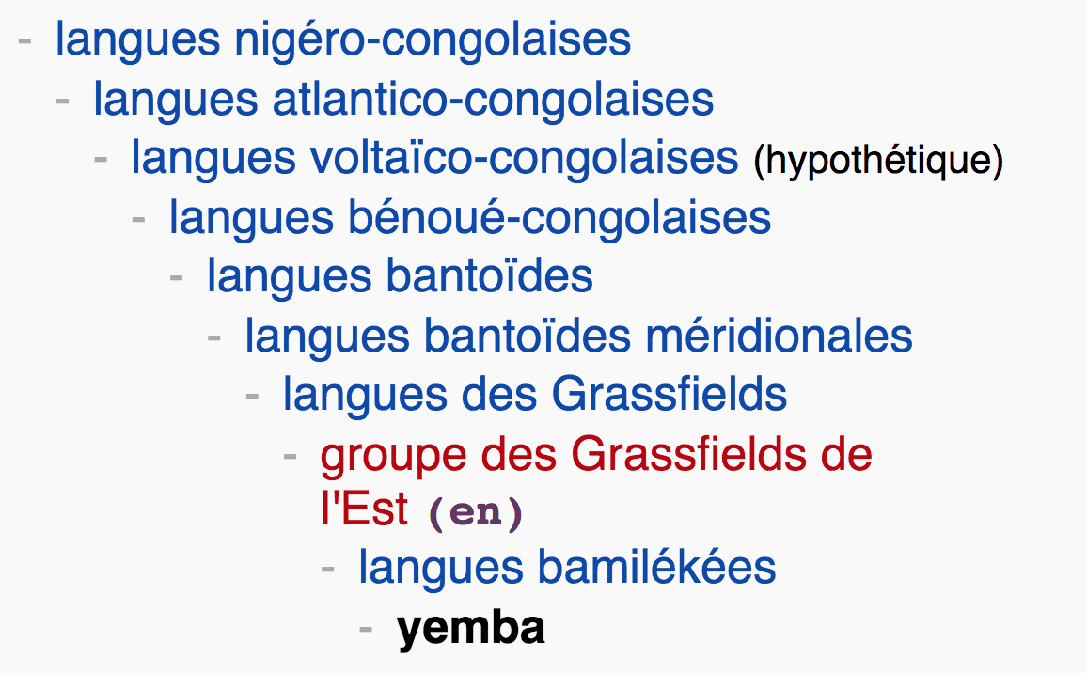
The Yemba language
language of West Cameroon poken by 300 000 (1992)
Meridionals Bantoïdes languages

Slide 7
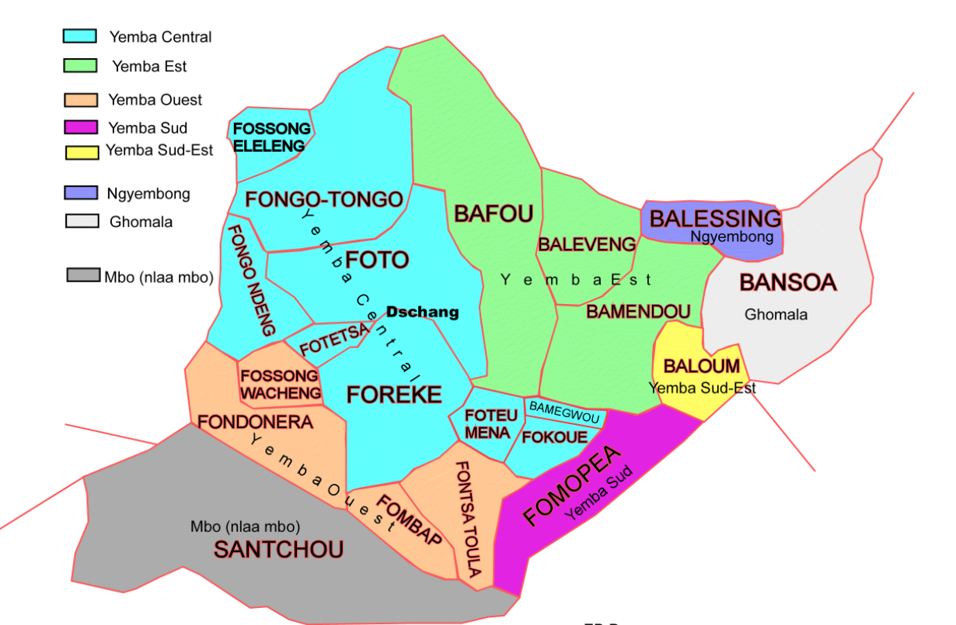
The Yemba language - variants

Slide 8
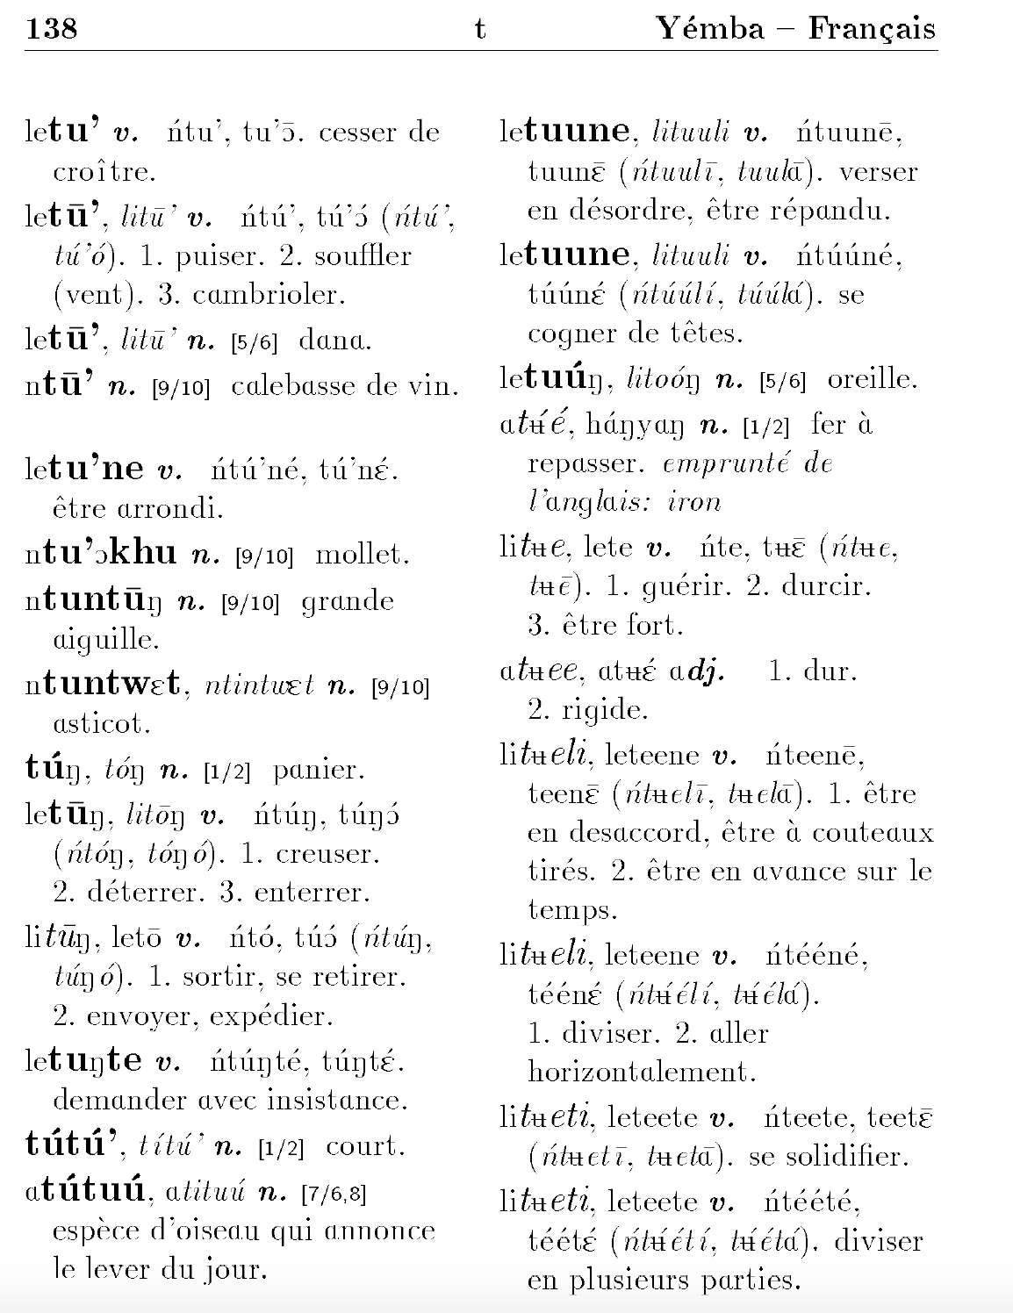
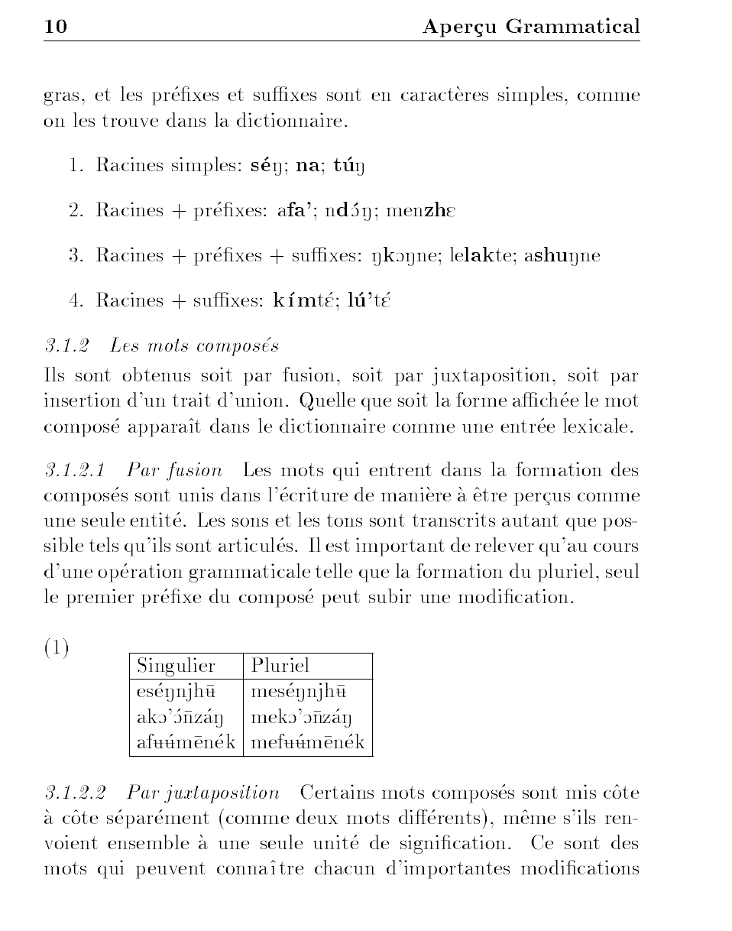
The Yemba language – Corpora
Traditional French-Yemba dictionnary, Steven Bird & Maurice Tadadjeu (ftp.cis.upenn.edu/pub/sb/papers/dictionary/dictionary.pdf )
    Morpholofy and syntax Overview
    More than 2100 worlds (Yemba- French)

Slide 9
The Yemba language – Corpora
Traditional French-Yemba dictionnary, Steven Bird & Maurice Tadadjeu (ftp.cis.upenn.edu/pub/sb/papers/dictionary/dictionary.pdf )
    Morpholofy and syntax Overview
    More than 2100 worlds (Yemba- French)

Slide 10
The Yemba language – Corpora
Some courses (bafou.org, eveilyemba.org )
Yemba radio for audio Corpora
Religious corpora (www.jw.org/ybb)

Slide 11
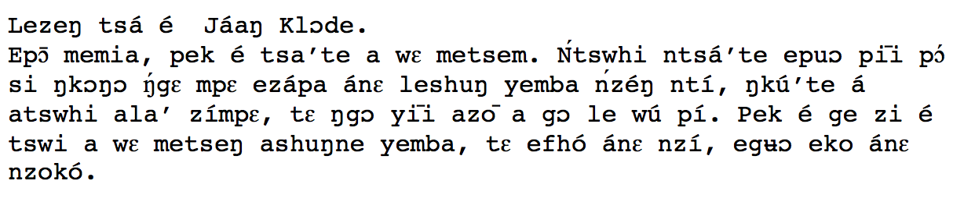
The Yemba language – Example
Je m’appelle Jean-Claude.
Chers Frères, je vous salue tous. Je salue en particulier tous ceux qui aimeraient que nous passions par la lecture et l’écriture de notre langue maternelle, pour garder notre culture, de sorte que rien ne puisse s’y perdre. Pour commencer nous allons vous apprendre l’alphabet Yemba de A à Z.

Slide 12
Under-resourced languages survey
Parallel Speech Collection for Under-resourced Language Studies Using the Lig-Aikuma Mobile Device App, David Blachon u. a.
Designing mobile applications for endangered languages, Steven Bird
Acoustic Modelling for Under-resourced Languages, Sebastian Stüker
Automatic speech recognition for under-resourced languages: A surveyLaurent Besacier u. a.

Slide 13
Why am I here?
First step of my project
Learn more about TEI
Creation of lexical content for Yemba language
Use acquired knowledge on others under-resourced languages

Slide 14



Time’s Up!
About your speaker:
  Name: Lionel TADJOU
  Institution: INRIA Paris
  Social Media:
    https://www.linkedin.com/in/tatali/
    @Ntatali
  Quick bio:
  Hold a Master degree.
  Research engineer at Inria Paris, Web developer for the PARTHENOS project, designing the Standardization Survival Kit (SSK) a platform dedicated to support research in Arts and Humanities researchers.

